Slide 1
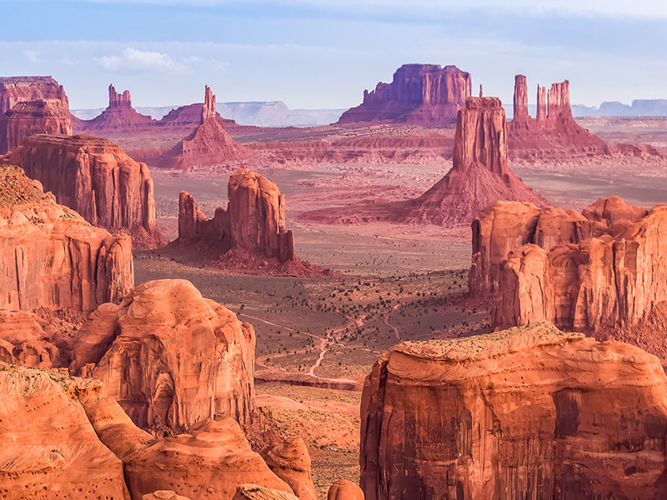
EART11100: Understanding the Earth
A dynamic Planet
Erosional landscape development

Slide 2
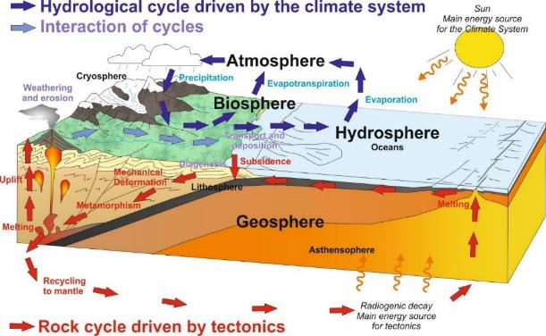
Intended learning outcomes
… you should be able to…
describe the main processes that form the different erosional landscape types across the world.
recognise that few landscapes are governed by a single process.

Slide 3
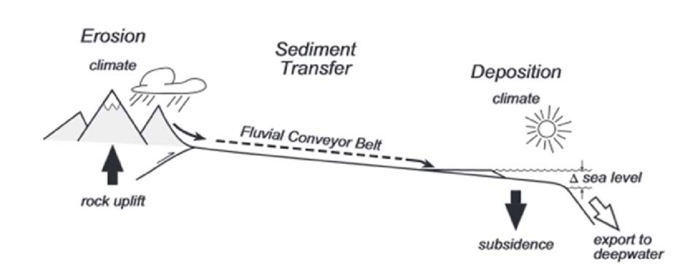
In this lecture…
Last time, we looked at vertical crustal movements
  The main controls on vertical crustal movement: isostacy, flexure and dynamic mantle effect
  And how vertical uplift forms high areas on the Earth’s surface (mountains or hinterlands), and subsidence forms Sedimentary Basins.

Slide 4
In this lecture…
Landscapes fall into two categories.
“Erosional Landscapes” – generated by uplift, weathering and erosion.
“Depositional Landscapes” generated by subsidence and deposition of sediment.
This week we focus exclusively on Erosional Landscapes, and how they form.

Slide 5
The difference between an erosional and depositional landscape
Because erosional landscapes are dominated by UPLIFT, and WEATHERING AND EROSION, they
  → tend to have topographic relief, and
  → are dominated surfaces covered in weathering products (“regolith”), or
  → or dominated by bare eroding bedrock.
By contrast, depositional landscapes are dominated by SUBSIDENCE and DEPOSITION of sediment. They are
  → low areas, either flooded by the lakes or sea, if they haven’t been filled with sediment, or
  → very flat (little relief) if they have been filled up with sediment.
  → characterised by bedrock buried under 10 to 100s m of sediment.
This week

Slide 6
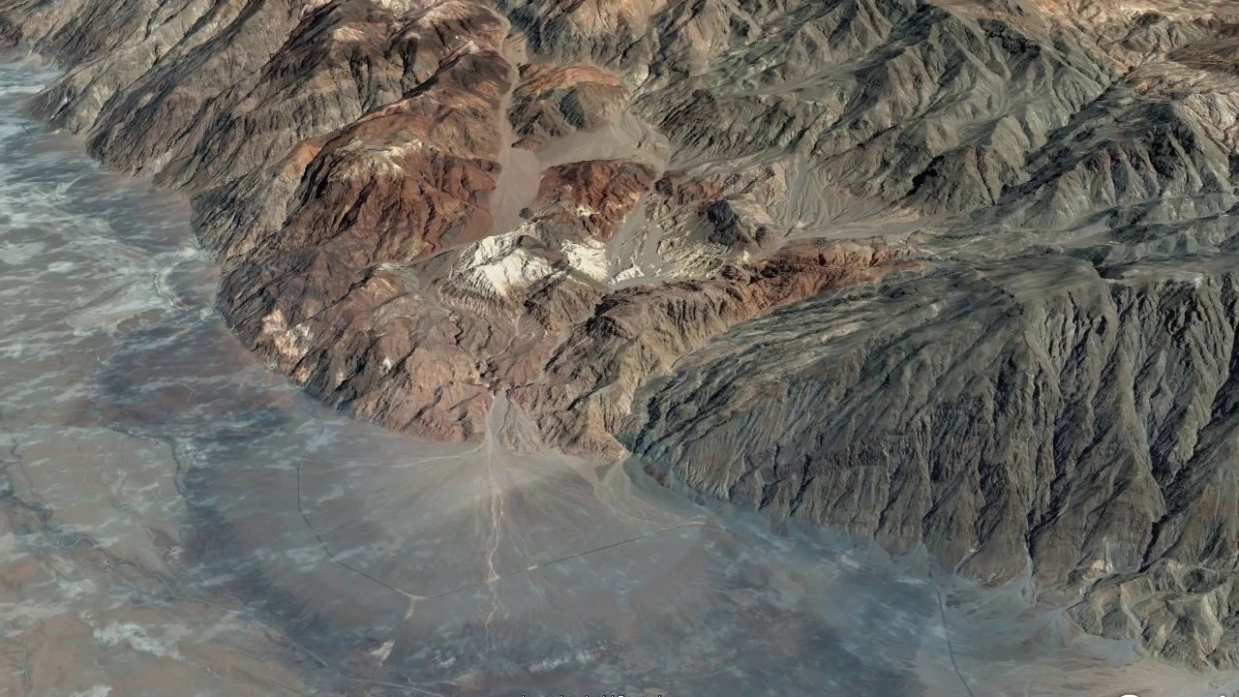
The difference between an erosional and depositional landscape
High relief
Bedrock and regolith at surface
Uplift
Low relief
Bedrock buried under thick sediment
Subsidence
(Normal) fault
Death Valley, California

Slide 7
EART11100: Understanding the Earth
A dynamic Planet
Weathering

Slide 8
Intended learning outcomes
… you should be able to…
describe the main controls on global weathering rates, and
use this information to explain where weathering happens to a greater and lesser degree.

Slide 9
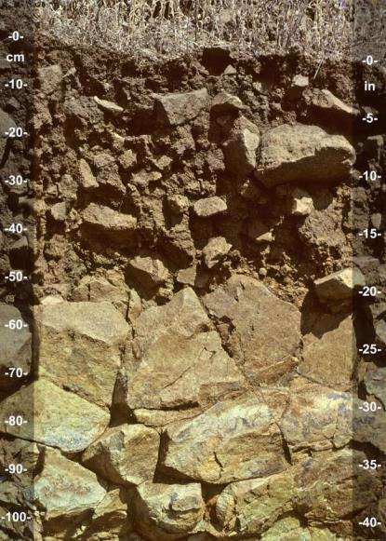
Controls on weathering rates
As the land surface us uplifted…
  →Via isostatic processes, lithospheric flexure, dynamic effects (W5)
  →Also via the formation of volcanoes (W3)
  …the newly available rock is weakened through weathering
This is the physical and chemical breakdown of the rock in place, at the surface.
  →The process of regolith and soil formation.
Victoria’s lecture

Slide 10
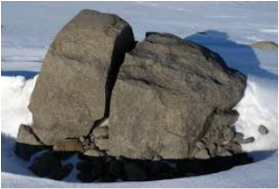
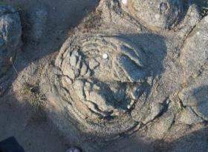
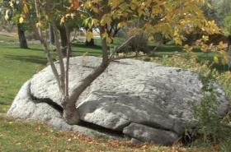
Controls on weathering rates
Physical weathering
  →Frost wedging (freeze-thaw)
  →Exfoliation (heat-cool, peeling)
  →Action of plants
Chemical weathering (always mediated by water)
  →Hydrolysis
  →Hydration
  →Carbonation
  →Oxidation
  →Ion exchange
  →Chelation
Lead to
→Formation of new minerals with different volumes
→Dissolution of minerals
Victoria’s lecture

Slide 11
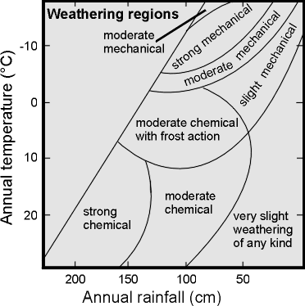
Controls on weathering rates
Rates of weathering are climate controlled.
Generally,
  →Areas of high rainfall provide the water that is necessary for chemical weathering.
  →In areas that are too cold, the water is in the solid phase (ice) and cannot mediate the chemical reactions.
  →In areas that are hot, higher temperatures speed up the rate of chemical weathering reactions.

Slide 12
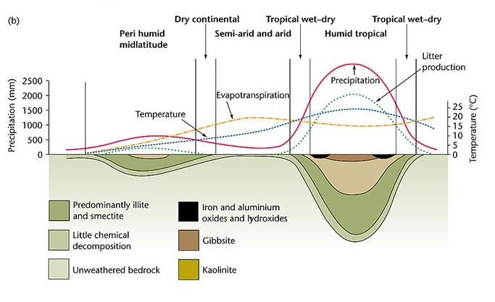
Controls on weathering rates
Thickness of weathered profile
K

Slide 13
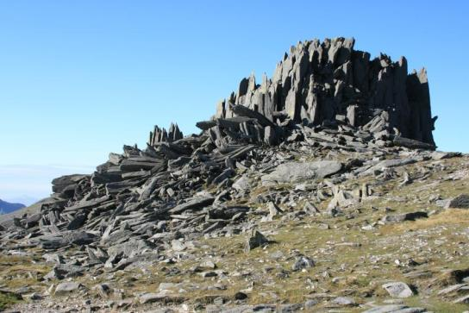
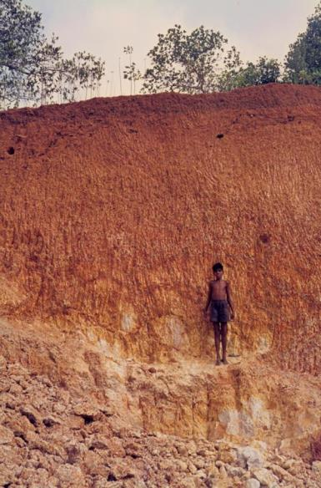
Controls on weathering rates
(Top) Blockfield and thin regolith at mid-high latitudes, and modest altitudes (1000 m), Snowdonia, UK.
(Right) Thickly developed laterite regolith at low latitude and low altitude, Kerala, India.

Slide 14
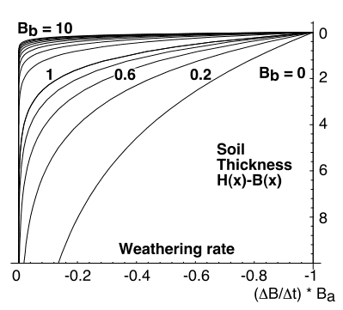
Controls on weathering rates
Rates of weathering are slope controlled.
Regolith growth is self-limiting.
  →reduction in grainsize and formation of clays reduced permeability, and limits access of water to for chemical weathering.
  →so weathering rate decreases downward in the regolith profile.
Source http://www.public.asu.edu/~arrows/geomorph/soil.GIF
However, if the regolith is readily removed, then water can access the reaction front.
So rapid (or continuous) removal of regolith increases weathering rates.

Slide 15
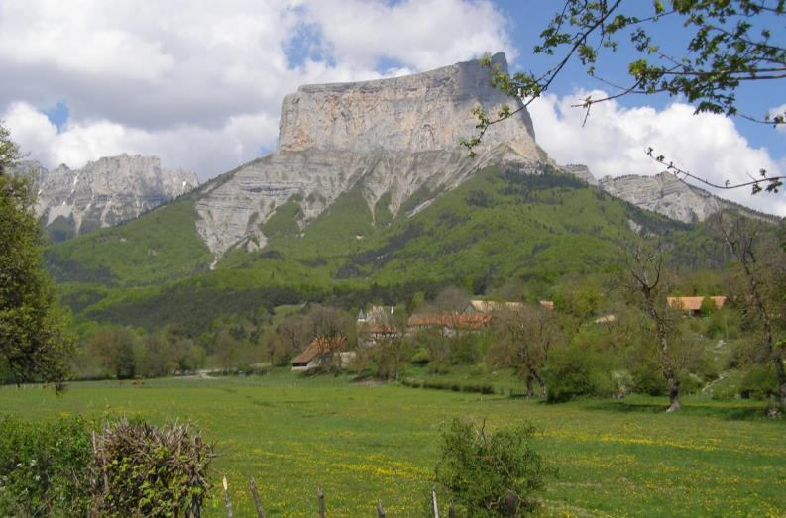
Controls on weathering rates
… and the rate of removal of regolith is related to slope gradient.
→Steep slope
→Instantaneous removal of regolith
→High weathering rate
→Moderate slope
→Moderate removal of regolith
→Moderate weathering rate
→Low gradient slope
→Low rate of removal of regolith
→Low weathering rate
Mont Aiguille, French Alps

Slide 16
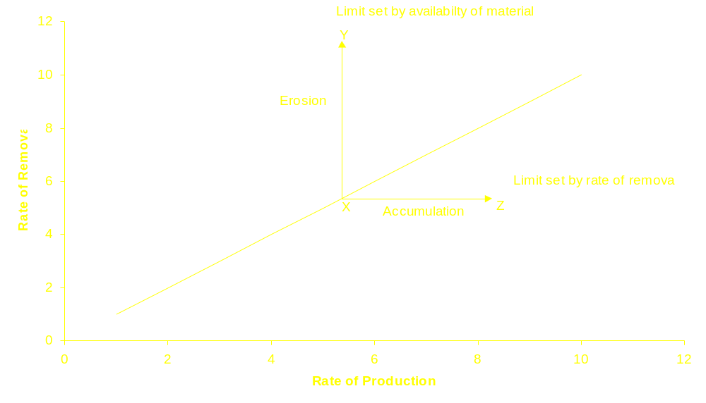
Controls on weathering rates
The concept of weathering-limited and transport-limited slopes.
On weathering-limited slopes, transport processes are so efficient that debris is removed more quickly than it can be generated by further weathering.
Transport-limited slopes occur where weathering processes are efficient at producing debris but where transport processes are inefficient at removing it from the slope

Slide 17
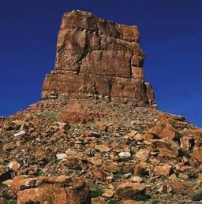
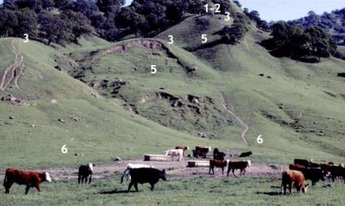
Controls on weathering rates
And we can readily recognise weathering-limited and transport-limited slopes in our environment.
Weathering-limited slopes:
Thin regolith
Transport-limited slopes: thick regolith
On weathering-limited slopes, transport processes are very efficient so debris is removed more quickly than it can be generated by further weathering.
Transport-limited slopes occur where weathering processes are efficient at producing debris but where transport processes are inefficient at removing it from the slope

Slide 18
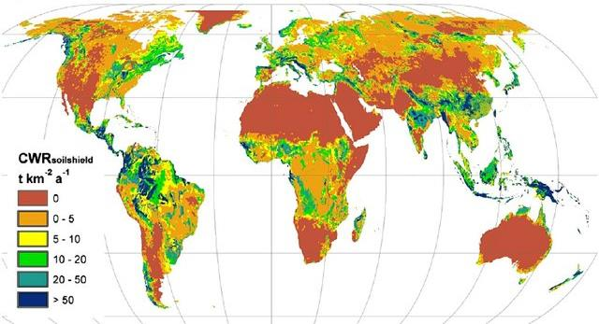
Summary: Controls on weathering rates
We see, then, that weathering rates (the rate of generation of sediment):
  Is high in areas of abundant rainfall and high temperatures
  Is high in areas of steep slope (and therefore topography)
  Note the positive feedback because of orographic rainfall (Dave’s lectures).

Slide 19
EART11100: Understanding the Earth
A dynamic Planet
Landscapes dominated by hillslope erosion (“hillslope geomorphology”)

Slide 20
Intended learning outcomes
… you should be able to…
describe the main hillslope erosion processes, where they happen, and the landforms (“geomorphology”) that result.

Slide 21
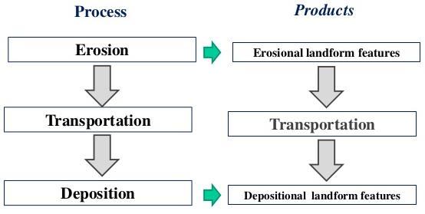
In this lecture…
In this lecture we will look at
  Erosion of weathered material, and the landforms that are generated
  Beginning with “hillslope” (aka “gravity”) erosion.

Slide 22
Hillsope processes
Erosion is the process of removal of the regolith that was generated through weathering, and its transport to a new location.
There are two main mechanisms for erosion
1. Gravity moves material from uplifted areas (mountains, hinterlands) to low areas (sedimentary basins)
  →The movement of material under its own gravitational potential in areas of steep slope.
2. Fluid flow exerts shear stress which moves material from one place to the next
  →The flow of water in streams and rivers (fluvial processes), which entrains sediment (gravity driven)
  →The flow of ice (glacial processes), which entrains sediment (gravity driven)
  →The flow of air (wind, or aeolian processes) from areas of high to low atmospheric pressure, which entrains sediment.

Slide 23
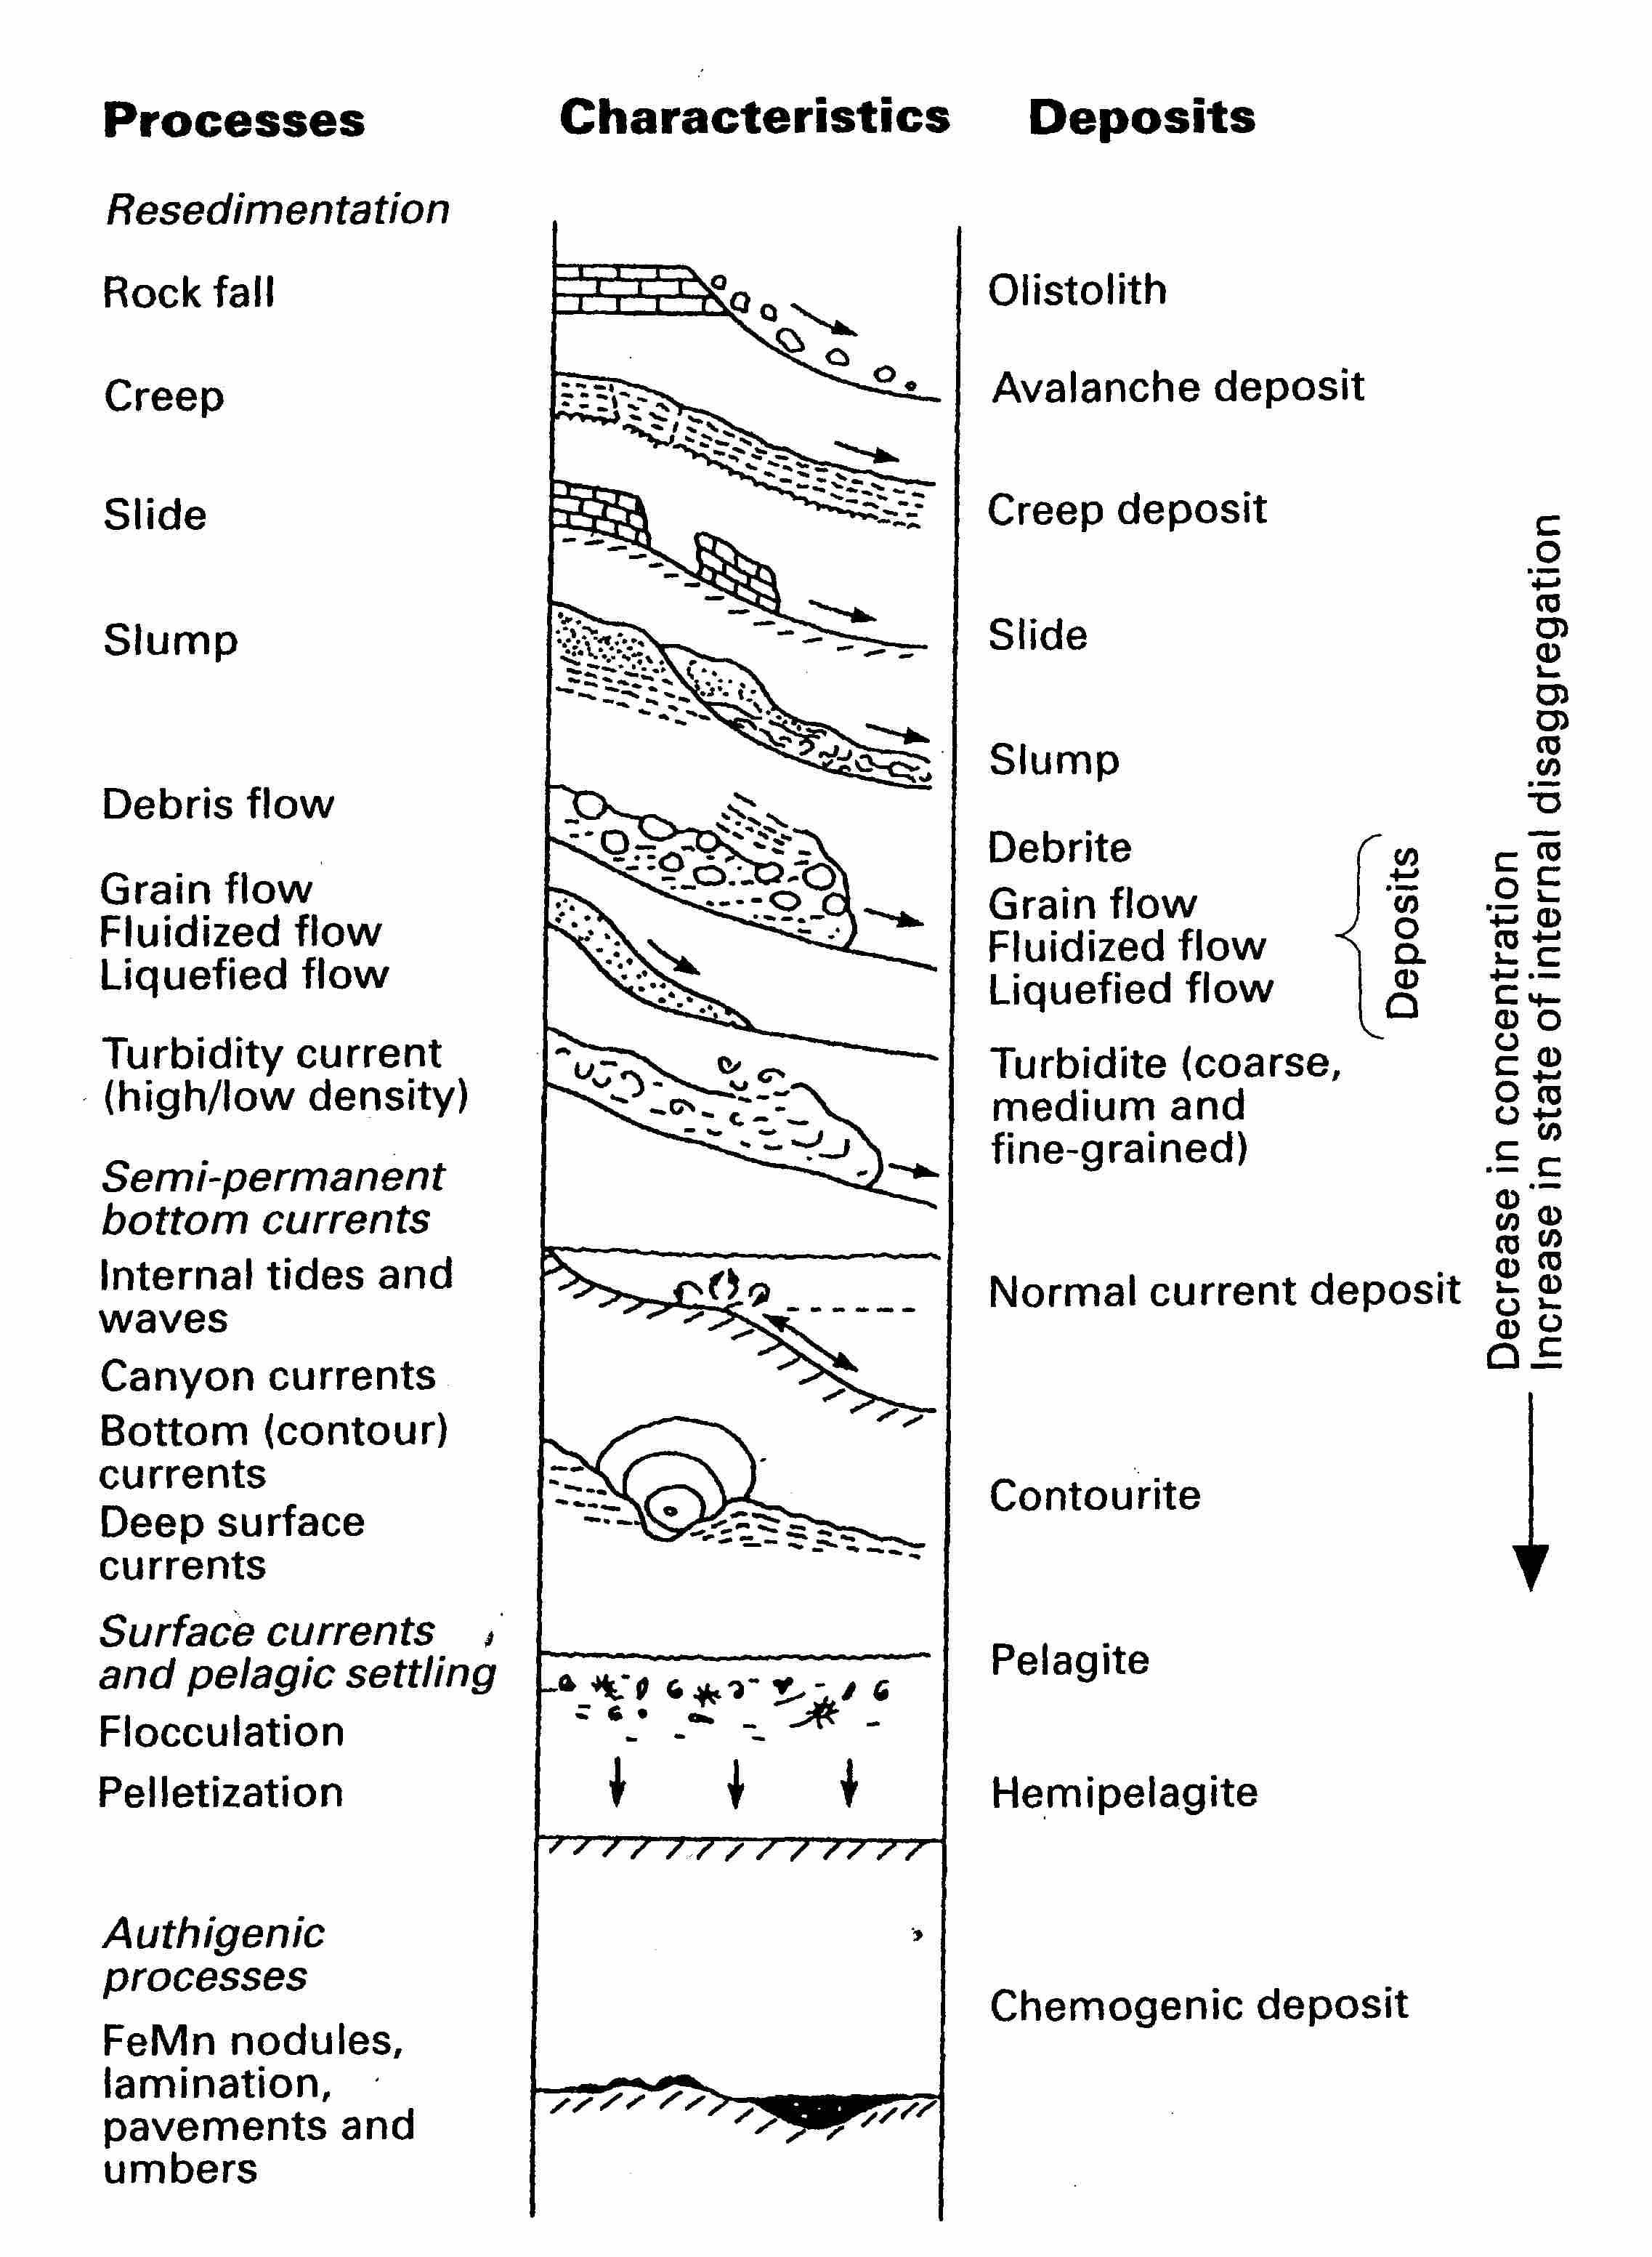
Hillsope processes
Steep surface topography (sometimes enhanced by fluvial and glacial erosion) lead to secondary erosional processes called mass wasting.
They are amongst the most spectacular erosion and transport processes.
They also represent hazards to life and infrastructure.
These can also happen in submarine settings (where the gradients permit).
Rock fall
Brittle
Slide
Slump (fast) and creep (slow)
Ductile
Decreasing strength of the sediment/regolith
Decreasing gradient required
Debris flow
Fluid
Turbidity and pyroclastic flows

Slide 24
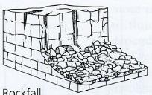
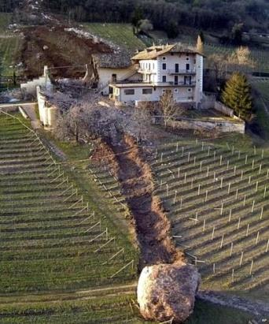
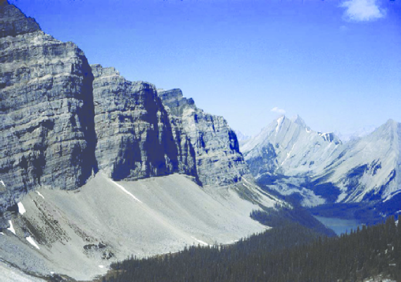
Hillsope processes
Fall – detachment occurs with little or no shear, movement occurs through free-fall, bouncing or rolling.
  →Common in glacial, canyon and sea-cliff geomorphic terranes with steep valley walls.
Fall
The clasts and the piles thereof are called talus, and are a good indicator of the process of falling.

Slide 25
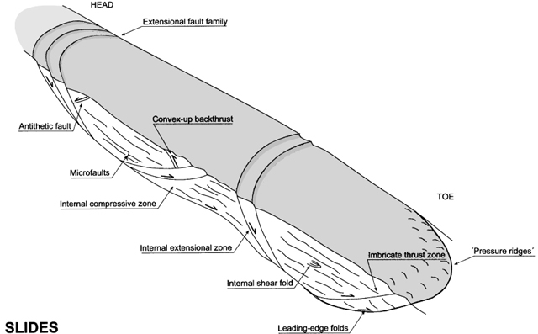
Hillsope processes
Slide – detachment and movement occurs along one or several surfaces of shear (a scar and fault), with limited brittle internal deformation (fracturing or faulting).

Slide 26
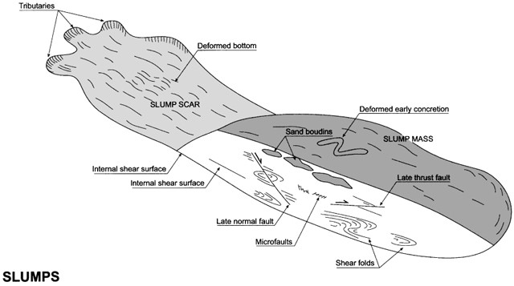
Hillsope processes
Slump – detachment and movement occurs along one or several surfaces of shear, with brittle and ductile internal deformation (faulting and folding).

Slide 27
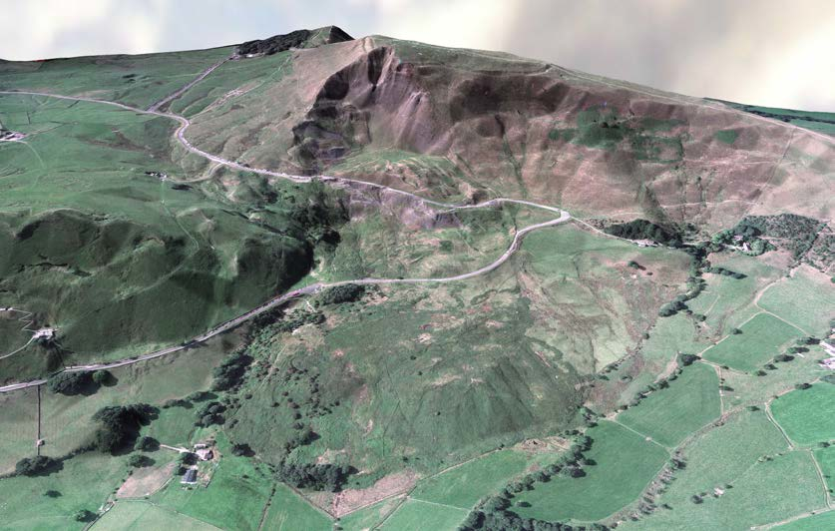
Hillsope processes
Slump scar (arcuate). Area of erosion.
Slump mass
The Mam Tor Slump closed the main highway between Manchester and Sheffield in the 1970s. It has been creeping for thousands of years.

Slide 28

Hillsope processes
Debris flows
Debris flows form where water saturated soil, sediment or regolith, fails – usually via catastrophic (rather than creeping) slumping
The kinetic energy imparted by the mass movement, causes grains to collide and bounce apart, allowing to flow freely between the grains, so that the material (even though it is composed of >50% grains) behaves as a fluid.
These pose a significant threat to society and infrastructure.
A debris flow disrupted the Tour-de-France in 2019
https://www.youtube.com/watch?v=VHKZrwJALSA
Also
https://www.youtube.com/watch?v=F9j9U2kR73w

Slide 29
Hillsope processes
As gradient is reduced by hillslope processes, there is a general change in behaviour.
Turbidity currents and pyroclastic flows are “special cases” associated with volcanoes and subaqueous (under water) conditions.
Eventually, gradients are insufficient to move material by their gravitational potential alone….
…fluvial processes take over.
Rock fall
Brittle
Slide
Slump (fast) and creep (slow)
Ductile
Decreasing strength of the sediment/regolith
Decreasing gradient required
Debris flow
Fluid
Turbidity and pyroclastic flows

Slide 30
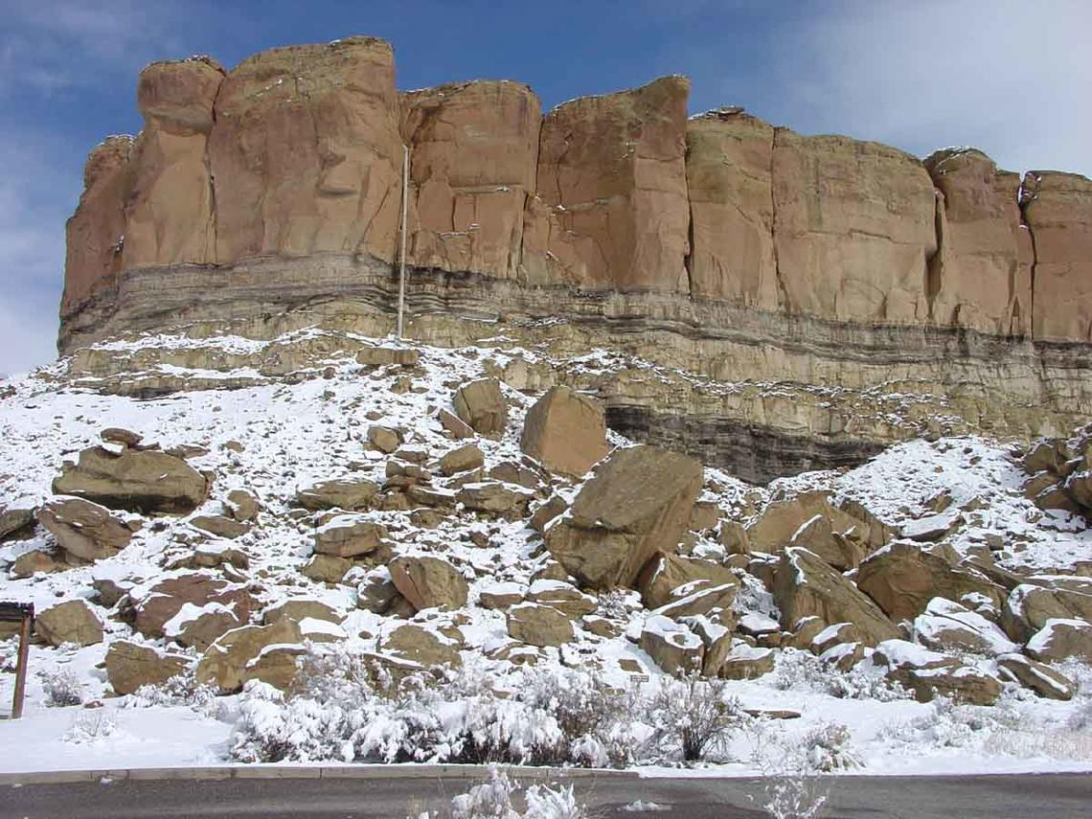
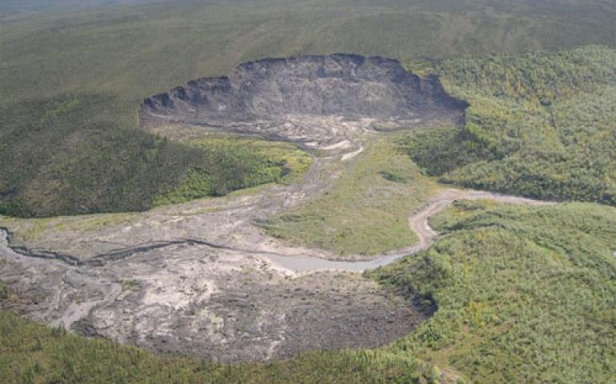
Summary
What to look for….

Slide 31
EART11100: Understanding the Earth
A dynamic Planet
Landscapes dominated by fluvial erosion (“fluvial geomorphology”)

Slide 32
Intended learning outcomes
… you should be able to…
describe the main fluvial erosion processes, where they happen, and the landforms (“geomorphology”) that result.

Slide 33
In this lecture…
In this lecture we will look at
  Erosion of weathered material, and the landforms that are generated
  Moving on to fluvial (aka river and stream) erosion.

Slide 34
Fluvial erosion and geomorphology
Erosion is the process of removal of the regolith that was generated through weathering, and its transport to a new location.
There are two main mechanisms for erosion
1. Gravity moves material from uplifted areas (mountains, hinterlands) to low areas (sedimentary basins)
  →The movement of material under its own gravitational potential in areas of steep slope.
2. Fluid flow exerts shear stress which moves material from one place to the next
  →The flow of water in streams and rivers (fluvial processes), which entrains sediment (gravity driven)
  →The flow of ice (glacial processes), which entrains sediment
  →The flow of air (wind, or aeolian processes) which entrains sediment.

Slide 35
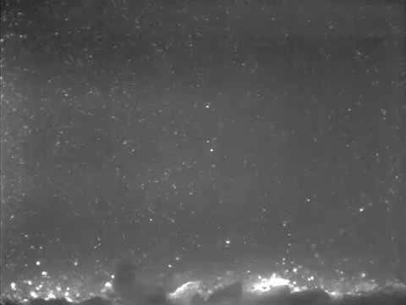

Fluvial erosion and geomorphology
As with weathering, water is the most important agent of erosion.
Rainfall, when it lands on the soil, flows downslope.
Because water has viscosity, it can impart a shear stress on particles, and
  →move grains as bedload
  →move grains as suspended load,
  →and as the universal solvent, dissolve and transport solute minerals.
Suspended load
Small particles
VIDEO
Bed load
Large particles
Roll and bounce

Slide 36
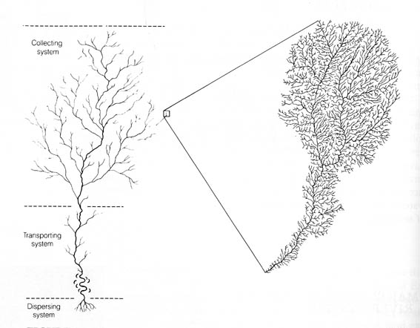
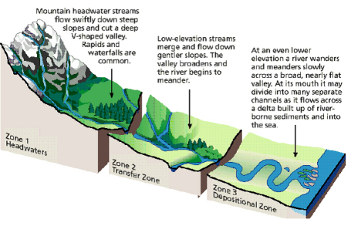
Fluvial erosion and geomorphology
Tributive Zone
→ erosion
As water flows down slope, rivulets and streams join together.
Intermediate
Distributive
→deposition
River systems that are eroding have a characteristic “tributive” plan view, which contrasts with the lower depositional reaches of the system.

Slide 37
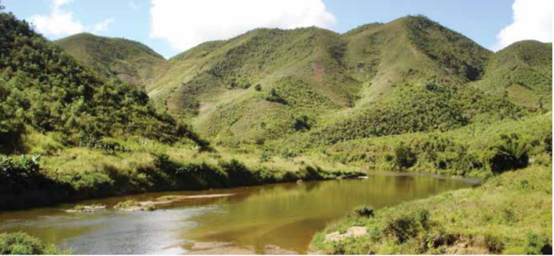
Fluvial erosion and geomorphology
Through erosion, rivers incise the uplifted land to form valleys.
Where (1) rocks are soft and (2) weathering (regolith development) rates are high, the steepened valley walls fail, via hillslope processes, in order to achieve at-equilibrium slopes.
Associated hillslope process: slumps and debris flows.
This leads to the characteristic v-shape profile of fluvial environments.
At equilibrium slope
At equilibrium slope
Tributary
In this example from Madagascar, a warm wet climate promotes weathering and failure of the slopes

Slide 38
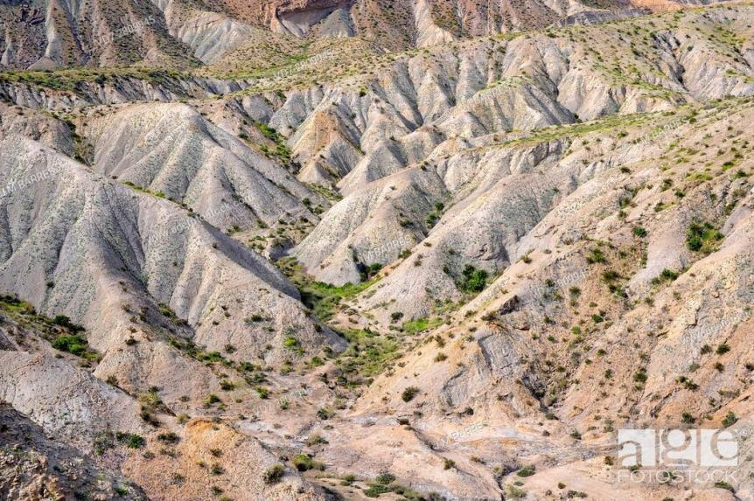
Fluvial erosion and geomorphology
Tributary
At equilibrium slope
At equilibrium slope
In this example from Tabernas, Spain, weathering rates are low. But, the rock is very soft, and low vegetation (whose roots can bind regolith together) promotes failure of the slopes: Badland geomorphology.

Slide 39
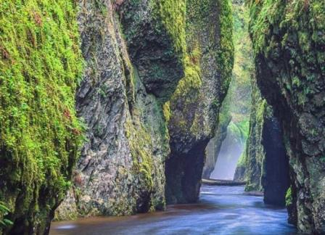
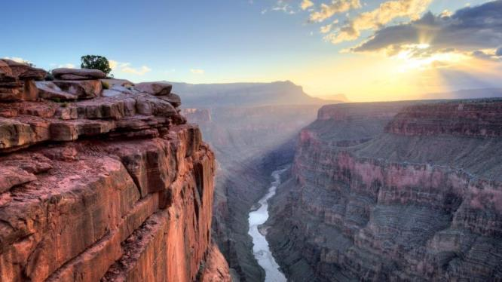
Fluvial erosion and geomorphology
Where (1) rocks are hard and (2) weathering (regolith development) rates are low, the steepened valley walls do not fail, and the valley walls remain steep, as the river carves ever more deeply.
This leads to the formation of canyon and gorge geomorphology.
Associated hillslope process: “falls”

Slide 40
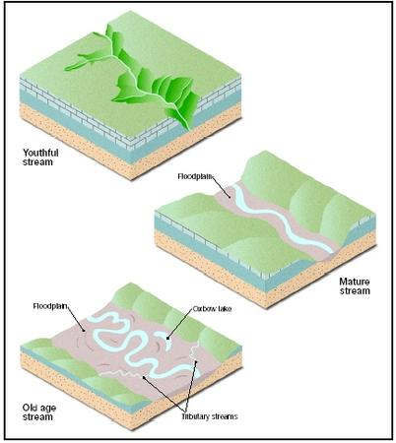
Fluvial erosion and geomorphology
Following the establishment of a fluvial erosional system, if erosion>uplift, it will “denude” the landscape
Leading to landscape evolution.
1. After uplift, newly established, “young” rivers have
Steep gradients (high elevation)
The river mainly erodes by downcutting and headward erosion (nickpoints)
The divides between rivers are broad, and undisected, because tributaries have had little time to form.

Slide 41
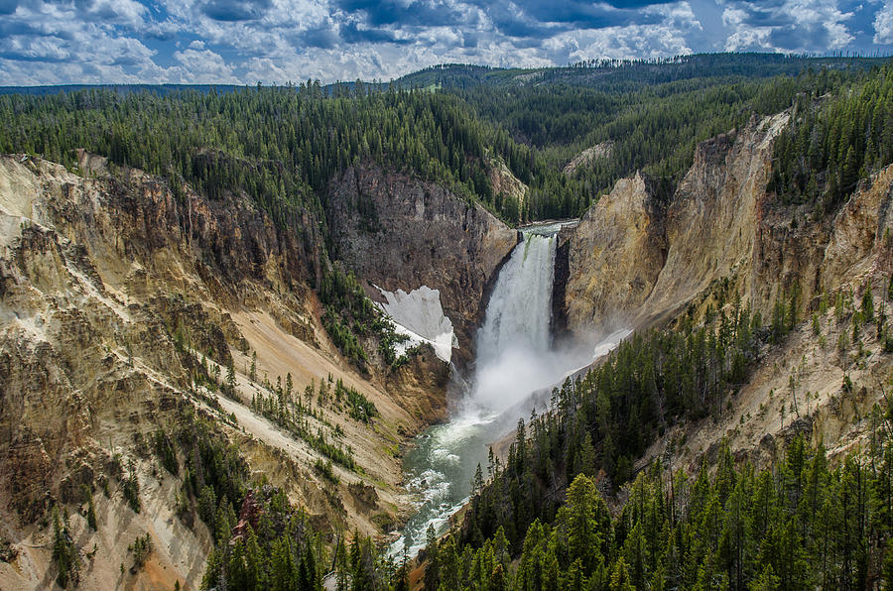
Fluvial erosion and geomorphology
Broad, undisected interfluve
Headward erosion
Downcutting
The Yellowstone river is a young system.

Slide 42
Fluvial erosion and geomorphology
2. In the intermediate state
Streams have fully dissected the former highlands
Whole area is covered by an extensive drainage network.
River erodes through horizontal sweeping and develops a flood plain (and meanders).
Slopes retreat, and interfluves become narrower
Landscape dominated by rolling hills between the main distributaries.

Slide 43
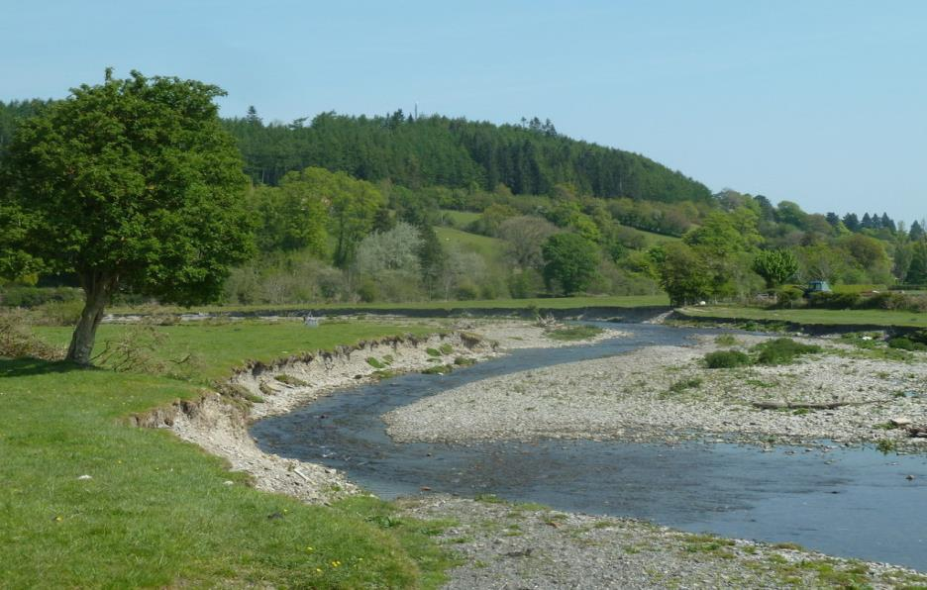
Fluvial erosion and geomorphology
Rounded hills between tributaries
Floodplain
Upper tributaries of the river Severn, UK.

Slide 44
Fluvial erosion and geomorphology
3. In the mature stage, the old river:
→Widens its flood plain further
→Slopes retreat until they meet, forming a flat featureless landscape.
→This surface is called a peneplain.

Slide 45
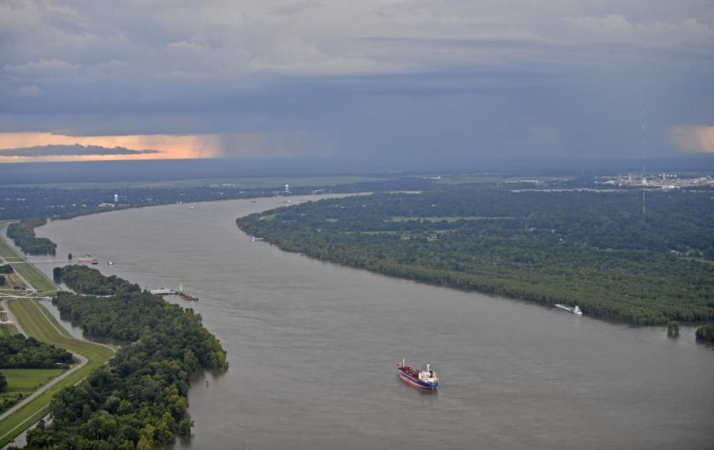
Fluvial erosion and geomorphology
The lower Mississippi valley has been occupied by the river for c. 40 Ma.
Peneplain

Slide 46
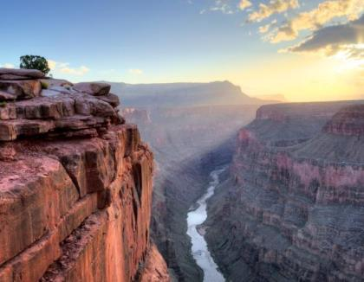
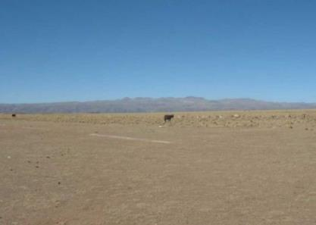

Fluvial erosion and geomorphology
“Old”
“Young”
“Mature”

Slide 47
Summary
What to look for….
High weathering, weak rock
Low weathering, strong rock
“Young”
“Mature”
“Old”

Slide 48
EART11100: Understanding the Earth
A dynamic Planet
Landscapes dominated by glacial erosion (“glacial geomorphology”)

Slide 49
Intended learning outcomes
… you should be able to…
describe the main glacial erosion processes, where they happen, and the landforms (“geomorphology”) that result.

Slide 50
In this lecture…
In this lecture we will look at
  Erosion of weathered material, and the landforms that are generated
  Moving on to fluvial (aka river and stream) erosion.

Slide 51
Fluvial erosion and geomorphology
Erosion is the process of removal of the regolith that was generated through weathering, and its transport to a new location.
There are two main mechanisms for erosion
1. Gravity moves material from uplifted areas (mountains, hinterlands) to low areas (sedimentary basins)
  →The movement of material under its own gravitational potential in areas of steep slope.
2. Fluid flow exerts shear stress which moves material from one place to the next
  →The flow of water in streams and rivers (fluvial processes), which entrains sediment (gravity driven)
  →The flow of ice (glacial processes), which entrains sediment
  →The flow of air (wind, or aeolian processes) which entrains sediment.

Slide 52
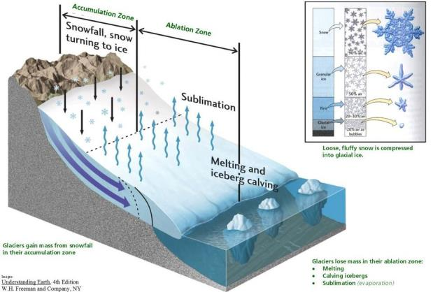
Glacial erosion and geomorphology
Ice caps and associated glaciers form because an excess of snow falls (relative to melting).
Compaction of the snow forms ice which behaves in a ductile to brittle manner, and can flow downhill, over timescales of years to 100s years.
Dave’s lecture

Slide 53
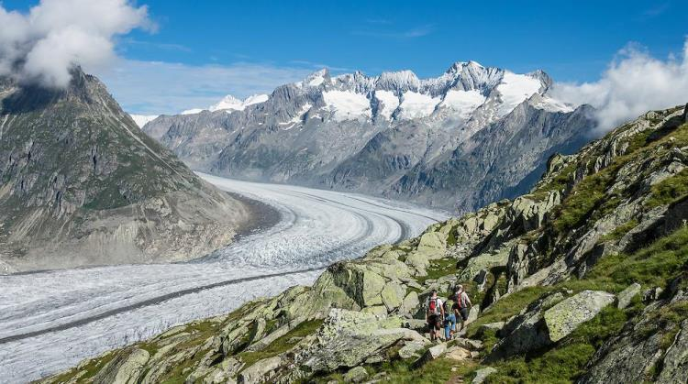
Glacial erosion and geomorphology
Ice is less dense than water, but it has a much higher viscosity, so its capacity to erode and transport material is enormous.
Typically, valley glaciers form in, and re-excavate major fluvial trunk river valleys.
The Aletsch Glacier, Switzerland, is the longest glacier in the Alps.

Slide 54
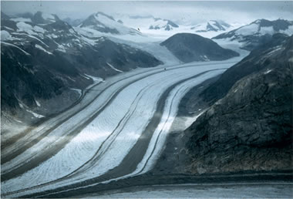
Glacial erosion and geomorphology
These are fed by ice-caps, or more minor hanging, or “cirque” glaciers which form in the former fluvial tributaries.
Hanging Glacier
The Bucher Valley Glacier, Alaska.

Slide 55
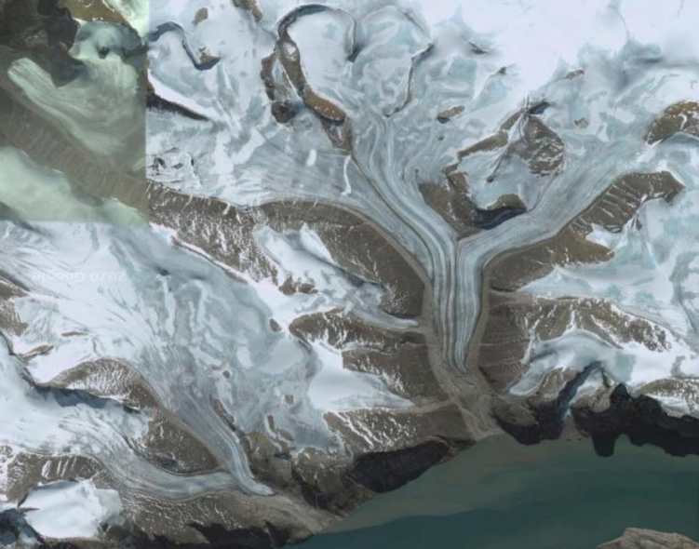
Glacial erosion and geomorphology
Baffin Island, Arctic Canada.

Slide 56
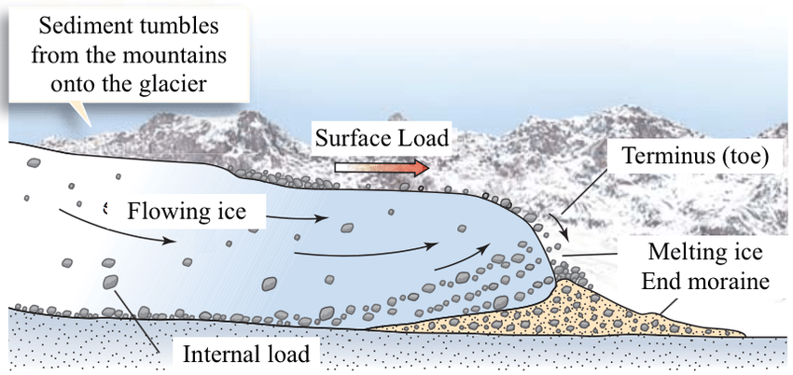
Glacial erosion and geomorphology
The glacier can erode and transport virtually any grainsize, either
  →as material that has fallen via gravity processes on to the top of the glacier
  →by melting and then freezing around, then “plucking” rocks from the interface of the glacier with bedrock.
  →by pulverising rock at the interface of the glacier with bedrock.
  →by pushing sediment that is in front of the glacier, during episodes of growth.

Slide 57
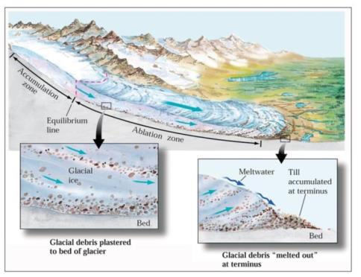
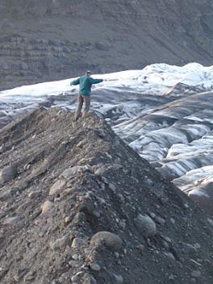
Glacial erosion and geomorphology
Glaciers thus deepen and widen the preexisitng valley, modifying its morphology.
  →The base of the glacier is relatively flat, and the sides relatively steep.
At the front of the glacier, the transported material is melted out in situ.
  → all the sediment is “dumped” in an unsorted manner in moraines.

Slide 58
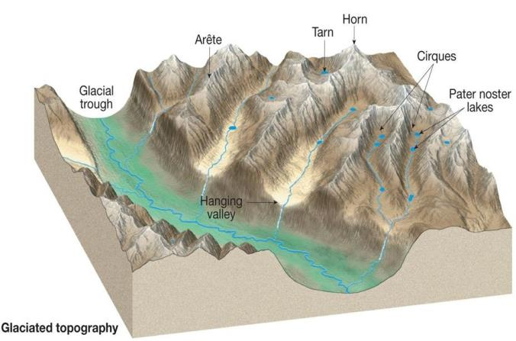
Glacial erosion and geomorphology
Ice retreat reveals a characteristic geomorphology of
  Over-deepened trunk valleys, with flat bottoms and steep sides (the famous “U” shape
  Typically with a “misfit” river.

Slide 59
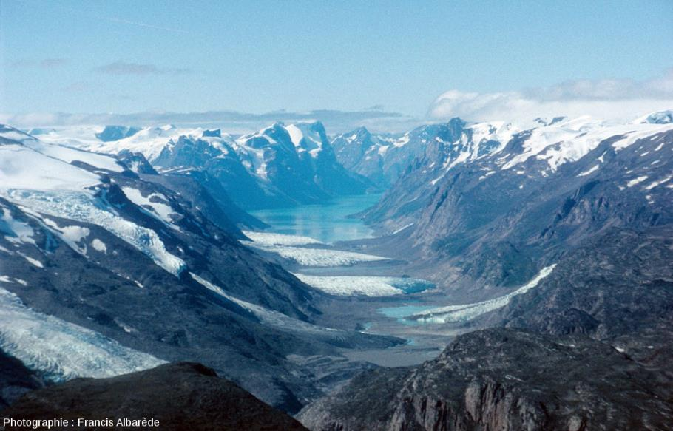
Glacial erosion and geomorphology
Recently deglaciated valley in Greenland.

Slide 60
Glacial erosion and geomorphology
Ice retreat reveals a characteristic geomorphology of
  Hanging valleys where tributary glaciers eroded down only to level of the top of the valley glacier

Slide 61

Glacial erosion and geomorphology
Yosemite National Park, California
Hanging Valley

Slide 62
Glacial erosion and geomorphology
Ice retreat reveals a characteristic geomorphology of
  Amphitheatre-like “cirques” often filled with and quasi-circular lakes (“tarns”) at the headwalls of valley glaciers.

Slide 63

Glacial erosion and geomorphology
Cirque de Gavarine, Pyrenees

Slide 64
Glacial erosion and geomorphology
Ice retreat reveals a characteristic geomorphology of
  Extremely narrow, steep ridges, called arretes, and steep “horns” (or “pyramidal peaks”, where the steep margins of glacial valleys have retreated towards one another.

Slide 65


Glacial erosion and geomorphology
The Matterhorn (right) is the eponymous “horn”
Crib Goch, Snowdonia (left) is an Arrete.

Slide 66




Glacial erosion and geomorphology
What to look for….
Arretes and Horns
Hanging valleys
U-shaped valleys
Cirques

